Slide 1
Learning Spark
Oreilly

Slide 2
Spark intro
One of the main features Spark offers for speed is the ability to run computations in memory
Spark makes it easy and inexpensive to combine different processing types (BIIS) batch applications, Iterative algorithms, Interactive queries, Streaming.
Spark is designed to be highly accessible, offering simple APIs in Python, Java, Scala, and SQL, and rich built-in libraries. It also integrates closely with other Big Data tools

Slide 3
multiple closely integrated components
all libraries and higher-level components in the stack benefit from improvements at the lower layers speed up as well. Spark’s core engine adds an optimization, SQL and machine learning libraries automatically
the costs associated with running the stack are minimized, because instead of running 5–10 independent software systems These costs include deployment, maintenance, testing, support
one of the largest advantages of tight integration is the ability to build applications that seamlessly combine different processing models

Slide 4
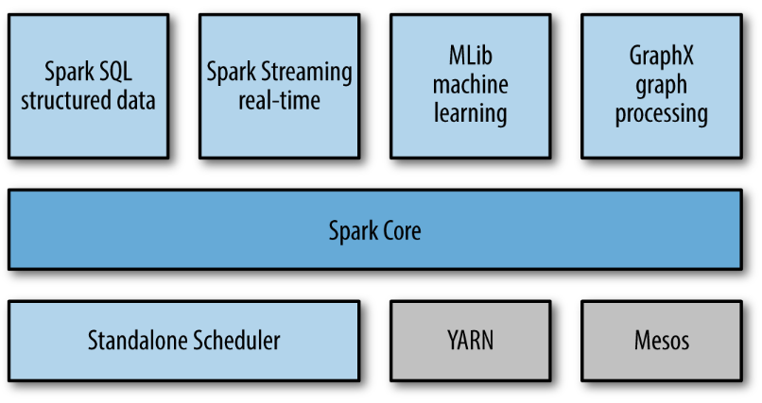
Spark Components

Slide 5
Spark Core
contains the basic functionality of Spark
including components for task scheduling, memory management, fault recovery, interacting with storage systems,
home to the API that defines resilient distributed datasets(RDDs),

Slide 6
Spark SQL
Spark’s package for working with structured data.
allows querying data via SQL as well as the Apache Hive
Spark SQL allows developers to intermix SQL queries with the programmatic data manipulations supported by RDDs in Python, Java, and Scala, all within a single application

Slide 7
Spark Streaming
. Spark Streaming provides an API for manipulating data streams
Spark Streaming was designed to provide the same degree of fault tolerance, throughput, and scalability as Spark Core.

Slide 8
Cluster Managers
Spark can run over a variety of cluster managers, including Hadoop YARN, Apache Mesos, and a simple cluster manager included in Spark itself called the Standalone Schedule

Slide 9
MLlib
MLlib provides multiple types of machine learning algorithms, including classification, regression, clustering, and collaborative filtering
provides some lower-level ML primitives, including a generic gradient descent optimization algorithm

Slide 10
A Brief History of Spark
Spark started in 2009 as a research project in the UC Berkeley RAD Lab
In 2011, the AMPLab started to develop higher-level components on Spark, such as Shark (Hive on Spark)¹ and Spark Streaming. These and other components are sometimes referred to as the Berkeley Data Analytics Stack (BDAS).
Spark was first open sourced in March 2010, and was transferred to the Apache Software Foundation in June 2013, where it is now a top-level project.

Slide 11
Spark application
consists of a driver program that launches various parallel operations on a cluster.
The driver program contains your program’s main function
Also defines your distributed datasets and apply operations on them
The driver program access spark through sparkContext Object

Slide 12
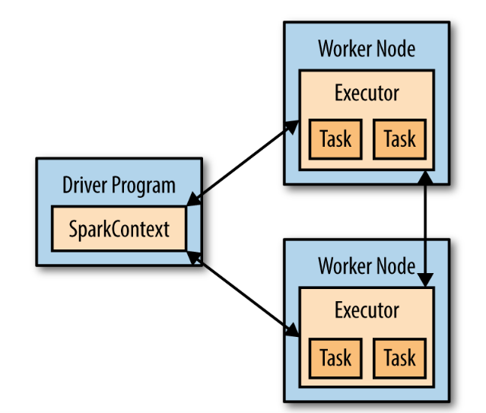
Spark App
Driver programs typically manage a number of nodes called executors Driver program contains spark context

Slide 13
RDD Basics CHAPTER 3
immutable distributed collection of objects. Each RDD is split into multiple partitions
Users create RDDs in two ways: by loading an external dataset, or by distributing a collection of objects
RDDs offer two types of operations: transformations and actions
Transformations construct a new RDD from a previous one.
Actions, on the other hand, compute a result based on an RDD, and either return it to the driver program or save it to an external storage system (e.g., HDFS)

Slide 14


Creating RDDs
Spark provides two ways to create RDDs: loading an external dataset and parallelizing a collection in your driver program.

Slide 15
RDD Operations
Transformations :operations that return new RDD
map( ) , filter( )
Actions : return computed result to driver program or save data into Disk Count( ) , first( )

Slide 16
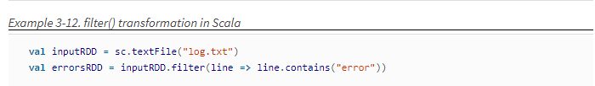
Transformations
RDDs are computed lazily only when using them in action
Many Transformations are Element Wise which means work on one elemenr at a time
Filter( ) doesn’t mutate input RDD , but creates a pointer for It

Slide 17
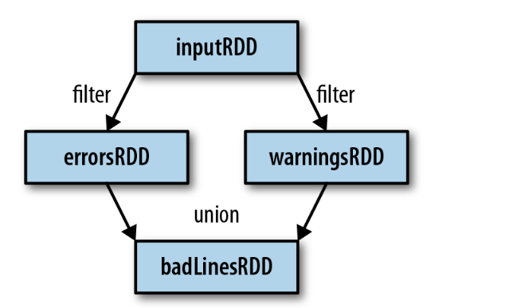
lineage graph
Keeps track for RDDS dependencies

Slide 18
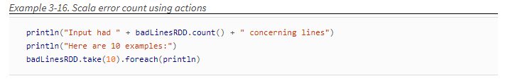
Actions
There are operations that returns a final value to the driver program or save result in external storage
Actions force required evaluation for transformations of RDD

Slide 19
Lazy Evaluation
Spark Will begin evaluate RDD once It seen an action
The operations are not immediately performed , but spark records meta data to indicate that operations are requested
Think of each RDD is some of instructions How to be computed

Slide 20
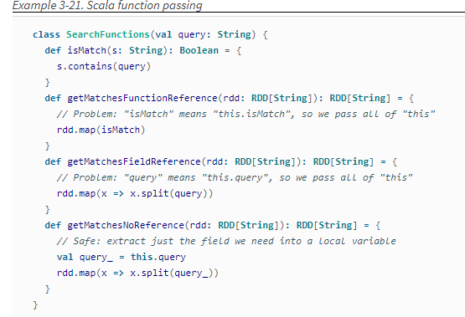
Passing Functions to Spark

Slide 21
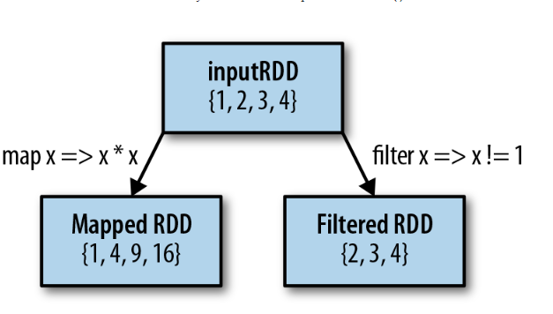
Common Transformations and Actions
Basic RDDs (Element wise )

Slide 22
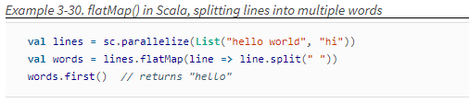
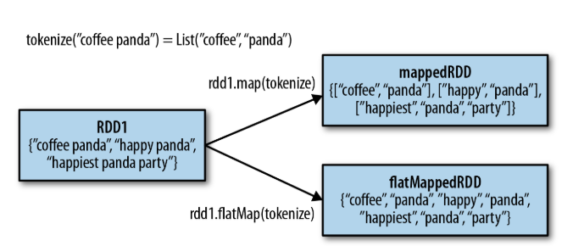
FlatMap( )
Called Individually for each element in RDD

Slide 23
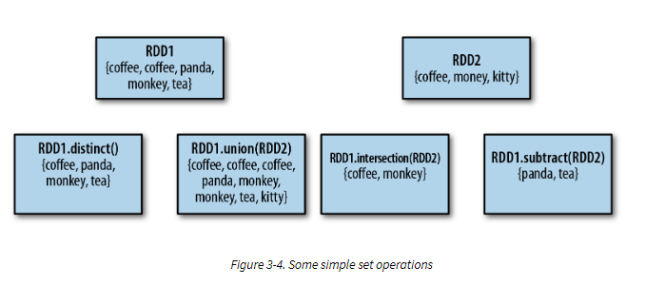
PSEUDO SET OPERATIONS

Slide 24

Actions
The most commonly action used is Reduce( )
Fold( ) is similar to reduce but takes a zero value in addition
Both fold and reduce require the return type to be the same as input type

Slide 25
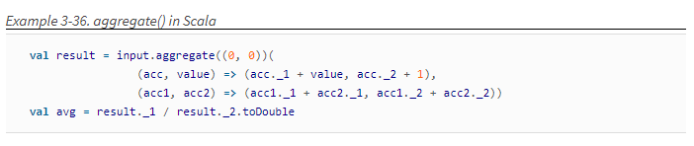
Aggregate( )
Free us from the constraint of returning same type of input RDD
We can use Aggregate to compute the average for RDD

Slide 26
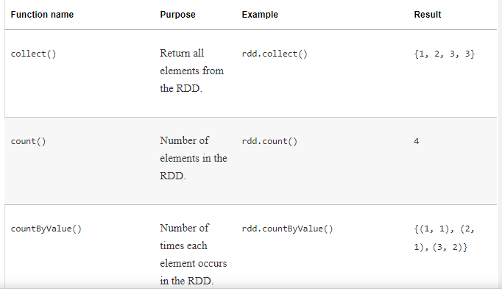
Some actions

Slide 27
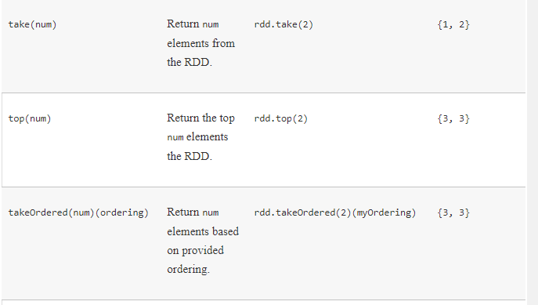
cont.

Slide 28
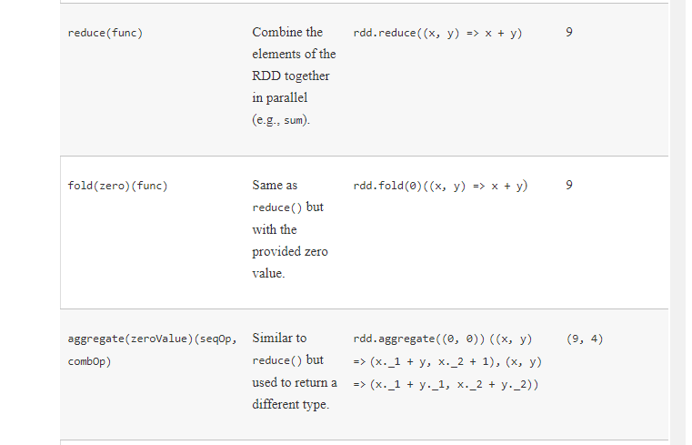
Cont.

Slide 29
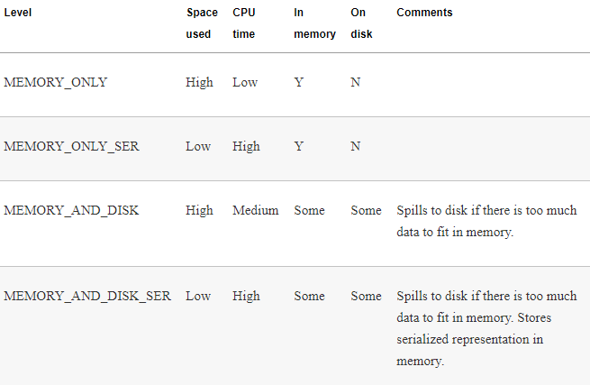
Persistence (Caching)

Slide 30
Unpresist
Spark will automatically evict old partitions using a Least Recently Used (LRU) cache policy. For the memory-only storage levels, it will recompute these partitions the next time they are accessed
You can delete RDD from cashing by calling unpresist()

